Slide 1

CS 484: Introduction to Machine Learning
Week 11
November 4, 2020

Slide 2
Week 11 Agenda: Neural Network
Perceptron
Gradient Descent
Backpropagation

Slide 3
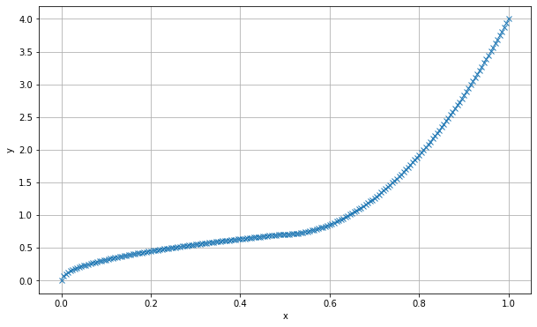

Can You See the Relationship?
Y and X are obviously related.
How can I describe the relationship?
Which parametric function?

Slide 4

Describe the Relationship Parametrically?
Exponential?
What is Growth Rate?
Polynomials?
How many degrees?
Logistic? Probit?
Censoring?
Mixture or Piecewise?
Proportions or Weights?

Slide 5

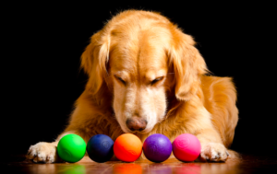
So Many Choices, So Little Time!
Neural Network uses an assembly of simple functions as building blocks to estimate the relationship
Can I use Neural Networks?

Slide 6
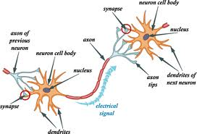
What is a Biological Neural Network?
An interconnected web of neurons transmitting elaborate patterns of electrical signals.
Dendrites receive input signals and based on those inputs, send an output signal via an axon.
A human brain contains about 100 billion neurons (give or take a few billion)

Slide 7
What is Our Artificial Neural Network?
Borrowed the idea from the biological neural network
The proper terminology is an Artificial Neural Network (ANN) which distinguish ours from the biological neural network
Our neural network is a linkage of many simple processors ("units")
Each unit has a limited amount of local transient memory
The units communicate via directional channels ("connections")
The units operate only on their local data and on the inputs, they receive via the connections.

Slide 8

Introduce the Perceptron
A single layer [artificial] neural network which has one hidden neuron
In the original definition, a perceptron takes several binary inputs and produces a single binary output
Developed by Frank Rosenblatt (1928 – 1971).
Principles of Neurodynamics: Perceptrons and the Theory of Brain Mechanisms, Spartan Books, 1962
The IEEE Frank Rosenblatt Award was established in 2004 and is named in honor of Frank Rosenblatt

Slide 9
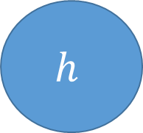
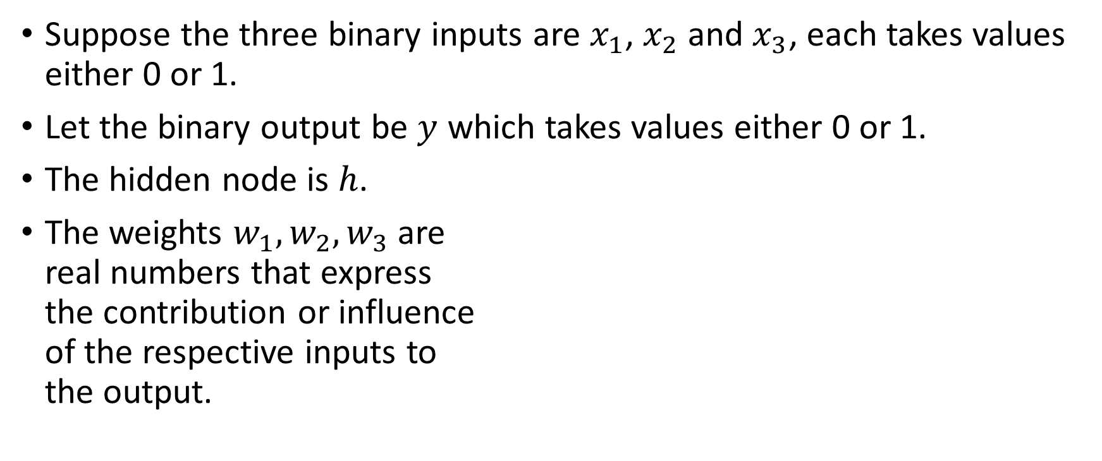
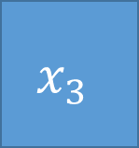
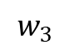
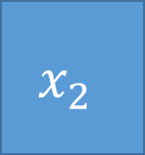
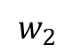

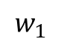

A Perceptron Example
Suppose the three binary inputs are $x_{1}$, $x_{2}$ and $x_{3}$, each takes values either 0 or 1.
Let the binary output be $y$ which takes values either 0 or 1.
The hidden node is $h$.
The weights $w_{1},w_{2},w_{3}$ are real numbers that express the contribution or influence of the respective inputs to the output.
$$x_{1}$$
$$w_{1}$$
$$x_{2}$$
$$h$$
$$y$$
$$w_{2}$$
$$x_{3}$$
$$w_{3}$$

Slide 10
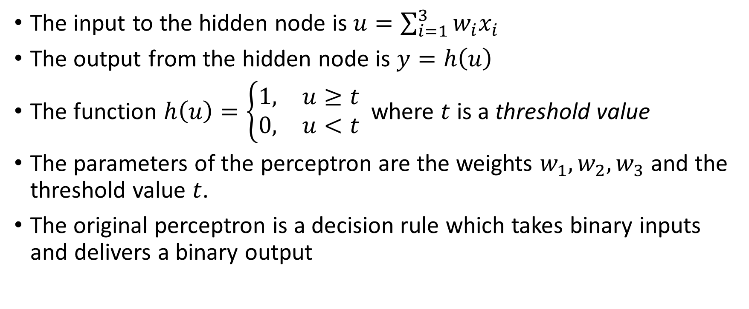
How Does the Original Perceptron Work?
The input to the hidden node is $u=\sum_{i=1}^{3}{w_{i}x_{i}}$
The output from the hidden node is $y=h\left(u\right)$
The function $h\left(u\right)=\left\{\begin{matrix}1, & u≥t \\ 0, & u<t\end{matrix}\right.$ where $t$ is a threshold value
The parameters of the perceptron are the weights $w_{1},w_{2},w_{3}$ and the threshold value $t$.
The original perceptron is a decision rule which takes binary inputs and delivers a binary output

Slide 11
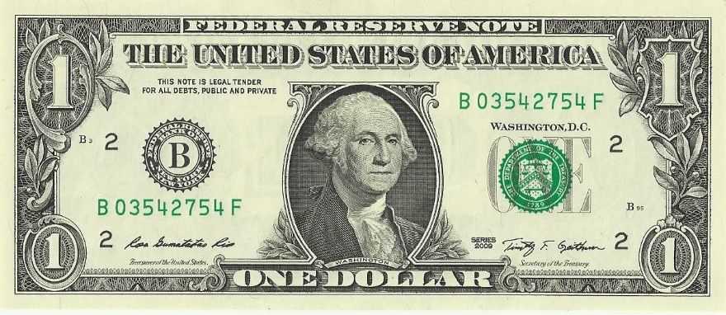
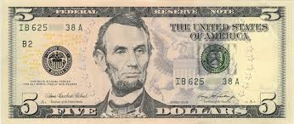


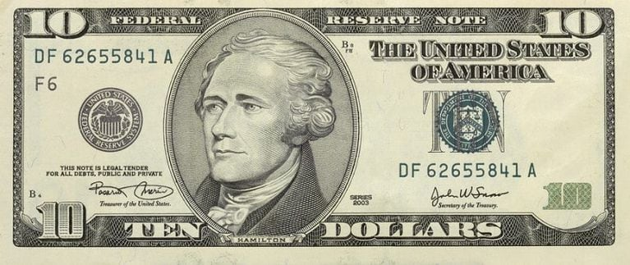
How to Pay for the Meal? (Another Perceptron Example)
You have three bills in your wallet
$6
Use (1) or
Not Use (0)?
Meal is Paid (1) or Not (0)?

Slide 12
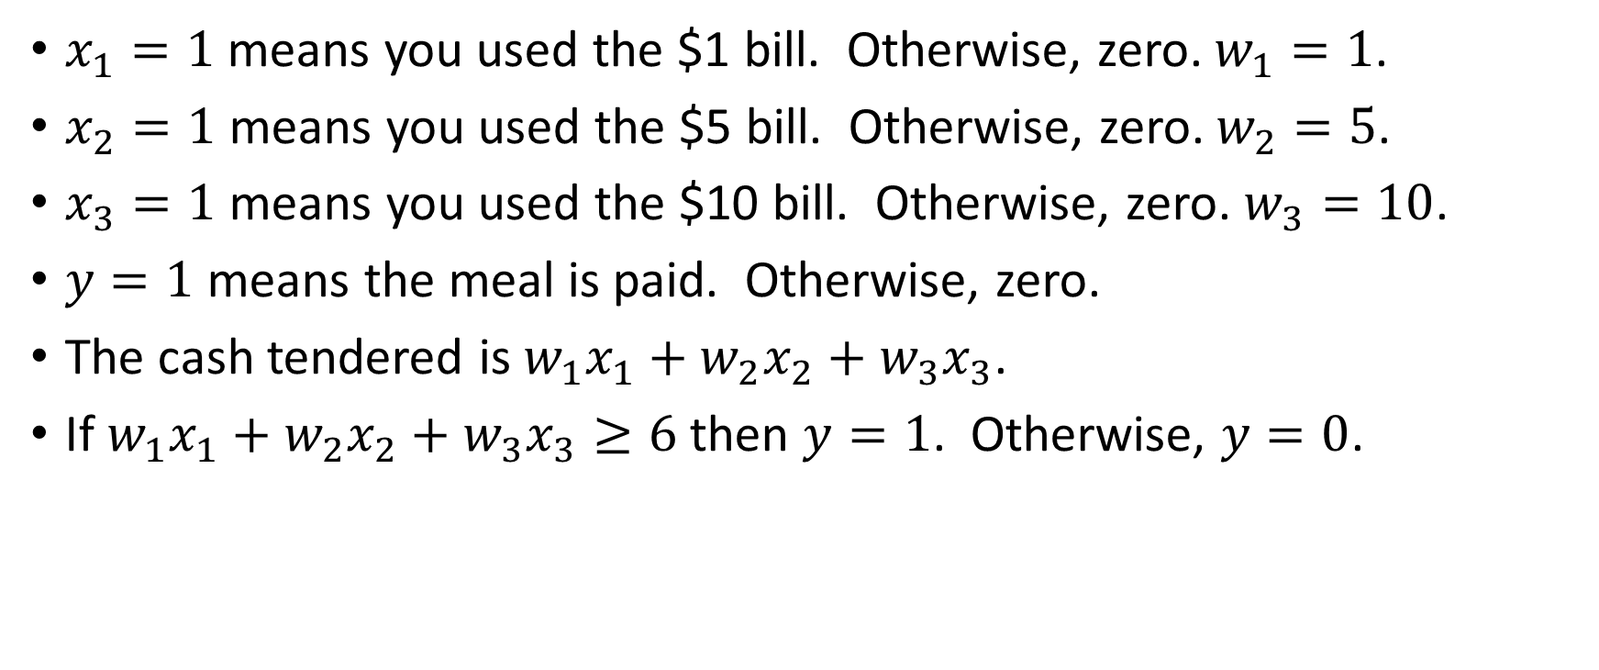
How to Pay for the Meal?
$x_{1}=1$ means you used the $1 bill. Otherwise, zero. $w_{1}=1$.
$x_{2}=1$ means you used the $5 bill. Otherwise, zero. $w_{2}=5$.
$x_{3}=1$ means you used the $10 bill. Otherwise, zero. $w_{3}=10$.
$y=1$ means the meal is paid. Otherwise, zero.
The cash tendered is $w_{1}x_{1}+w_{2}x_{2}+w_{3}x_{3}$.
If $w_{1}x_{1}+w_{2}x_{2}+w_{3}x_{3}≥6$ then $y=1$. Otherwise, $y=0$.

Slide 13
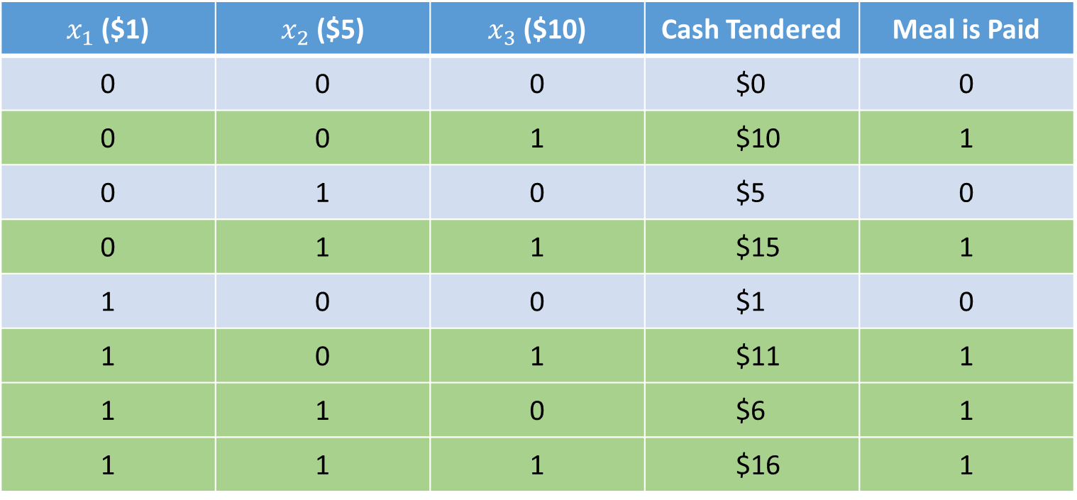
Many Ways to Pay for the Meal …
$x_{1}$ ($1) | $x_{2}$ ($5) | $x_{3}$ ($10) | Cash Tendered | Meal is Paid
0 | 0 | 0 | $0 | 0
0 | 0 | 1 | $10 | 1
0 | 1 | 0 | $5 | 0
0 | 1 | 1 | $15 | 1
1 | 0 | 0 | $1 | 0
1 | 0 | 1 | $11 | 1
1 | 1 | 0 | $6 | 1
1 | 1 | 1 | $16 | 1

Slide 14
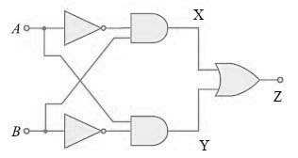
The XOR Gate (A Two Perceptrons Example)
The XOR gate implements the Exclusive OR function
Z = A XOR B = (A AND NOT B) OR (NOT A AND B)
The output is True only when either input is True but not both
A | B | Z
True | True | False
True | False | True
False | True | True
False | False | False

Slide 15
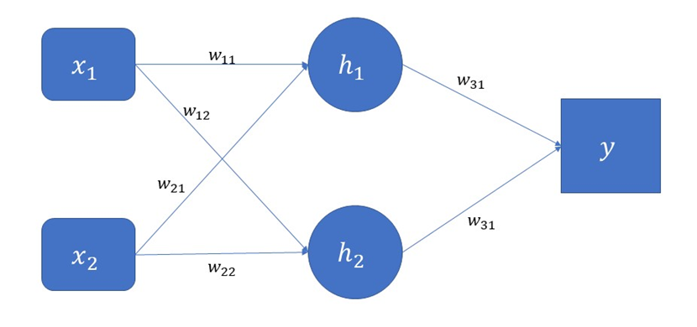
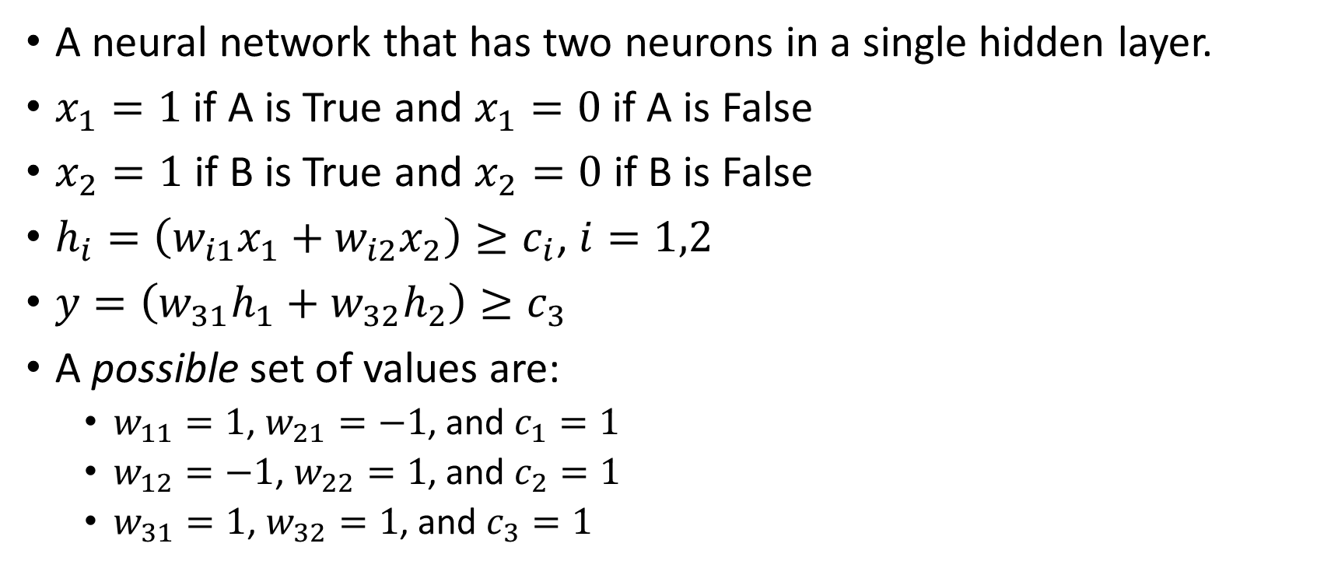
The XOR Gate
A neural network that has two neurons in a single hidden layer.
$x_{1}=1$ if A is True and $x_{1}=0$ if A is False
$x_{2}=1$ if B is True and $x_{2}=0$ if B is False
$h_{i}=\left(w_{i1}x_{1}+w_{i2}x_{2}\right)≥c_{i}$, $i=1,2$
$y=\left(w_{31}h_{1}+w_{32}h_{2}\right)≥c_{3}$
A possible set of values are:
$w_{11}=1$, $w_{21}=−1$, and $c_{1}=1$
$w_{12}=−1$, $w_{22}=1$, and $c_{2}=1$
$w_{31}=1$, $w_{32}=1$, and $c_{3}=1$

Slide 16
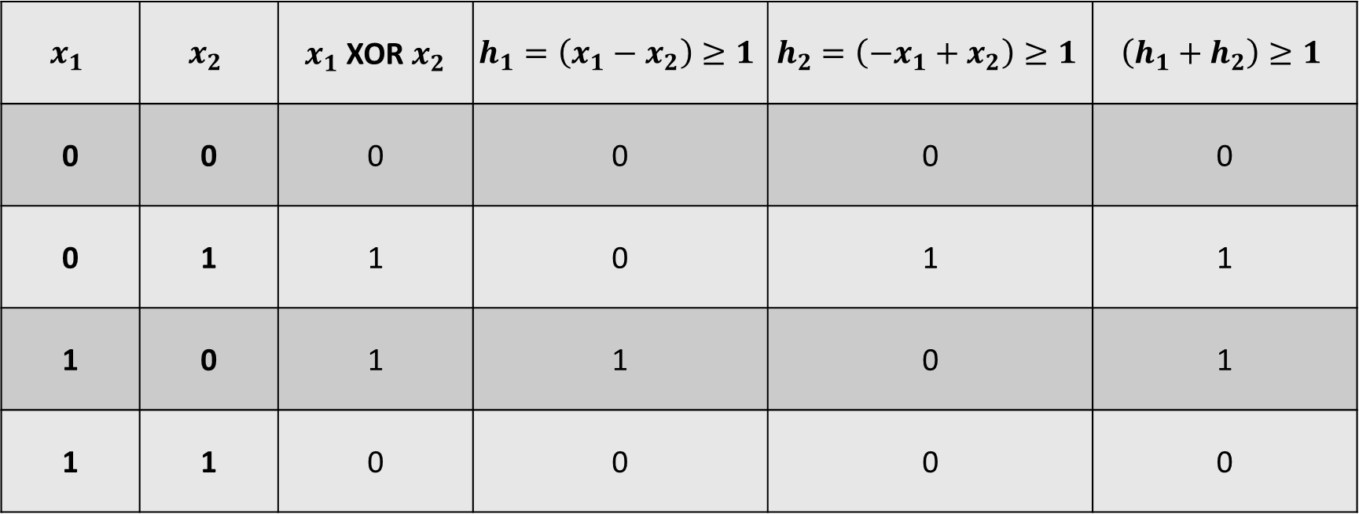
The XOR Gate
$$x_{1}$$ | $$x_{2}$$ | $x_{1}$ XOR $x_{2}$ | $$h_{1}=\left(x_{1}−x_{2}\right)≥1$$ | $$h_{2}=\left({−x}_{1}+x_{2}\right)≥1$$ | $$\left(h_{1}+h_{2}\right)≥1$$
0 | 0 | 0 | 0 | 0 | 0
0 | 1 | 1 | 0 | 1 | 1
1 | 0 | 1 | 1 | 0 | 1
1 | 1 | 0 | 0 | 0 | 0
(1 = True, 0 = False)

Slide 17
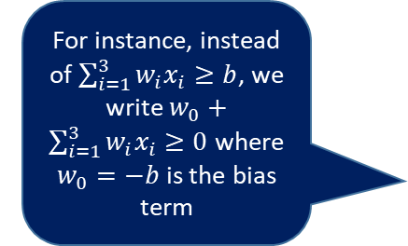
Build Neural Network on Perceptrons
Add more layers and increase the number of hidden neurons in the layers
Change the role of the threshold value as a bias term in the layer
Generalize the output from a hidden neuron from 0 or 1 integers to any numbers
Replace the final output from a discrete decision to the continuous value of the decision
For instance, instead of $\sum_{i=1}^{3}{w_{i}x_{i}≥b}$, we write $w_{0}+\sum_{i=1}^{3}{w_{i}x_{i}}≥0$ where $w_{0}=−b$ is the bias term
The probabilities of take the decision choices or the numerical value of the decision

Slide 18
Introduce the Multi-Layer Perceptron (MLP)
Bias
Y1
H(2:0)
H(1:0)
H(3:0)
X1
H(2:1)
Y2
X2
H(1:1)
H(3:1)
H(2:2)
Y3
X3
Input Layer
Hidden Layer(s)
Output Layer

Slide 19
Structure of a Multi-Layer Perceptron (MLP)
Units
Input Layer
Hidden Layer(s)
Output Layer
Bias
Synaptic Weights
Combination Function
Activation Function
Error Function
Cost Function

Slide 20
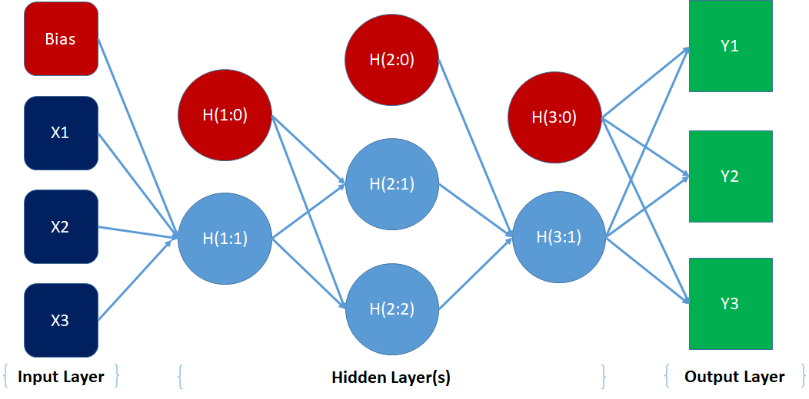
Structure of a Multi-Layer Perceptron (MLP)
The units are entities in the neural network diagram.
The input layer contains the input variables and the optional bias unit.
The hidden layers contain unobservable units, including the optional hidden bias units.
The output layer contains the target variables.

Slide 21
Structure of a Multi-Layer Perceptron (MLP)
The bias unit represents the baseline input into the succeeding units. It is like the intercept term in regression.
The synaptic weights are numbers (positive, zero, or negative) that indicate the size of the signal from a preceding unit to a succeeding unit.
The combination function combines weights and values of preceding units into a single value that feed into the activation function.
The activation function transforms the result of combination function into the value for the succeeding unit.

Slide 22
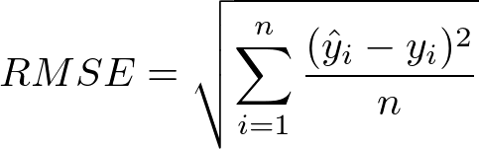
Structure of a Multi-Layer Perceptron (MLP)
The error function measures the discrepancy between the network output values and the observed target values.
The cost function is what you will minimize in building the network.
Example of a Cost Function
Error Function
Cost Function

Slide 23
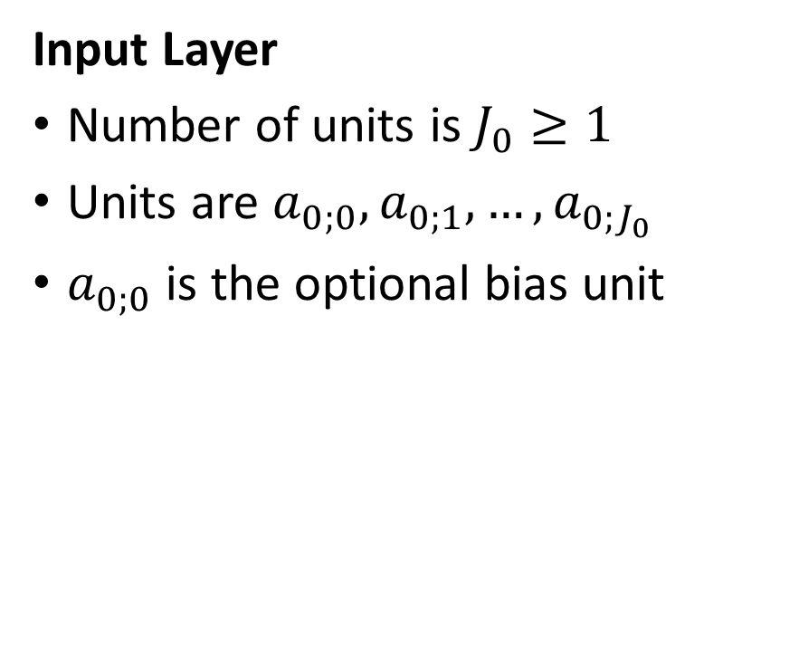
The Mathematical Representation
Input Layer
Number of units is $J_{0}≥1$
Units are ${a_{0;0},a}_{0;1},…,a_{0;J_{0}}$
$a_{0;0}$ is the optional bias unit

Slide 24
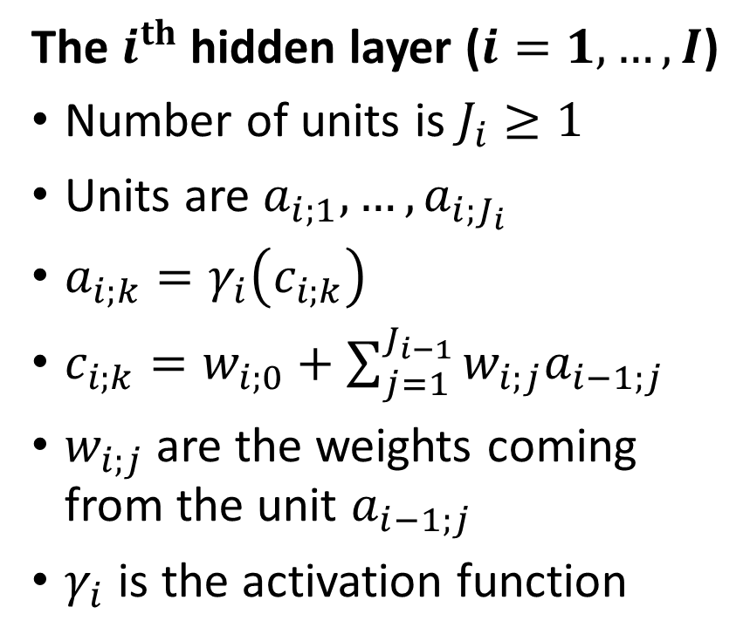
The Mathematical Representation
The $i^{th}$hidden layer ($i=1,…,I$)
Number of units is $J_{i}≥1$
Units are $a_{i;1},…,a_{i;J_{i}}$
$a_{i;k}=γ_{i}\left(c_{i;k}\right)$
$c_{i;k}=w_{i;0}+\sum_{j=1}^{J_{i−1}}{w_{i;j}a_{i−1;j}}$
$w_{i;j}$ are the weights coming from the unit $a_{i−1;j}$
$γ_{i}$ is the activation function

Slide 25
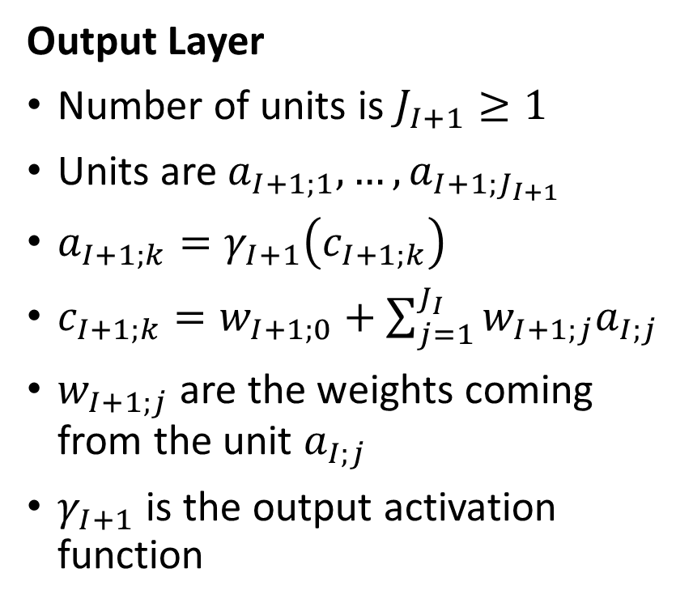
The Mathematical Representation
Output Layer
Number of units is $J_{I+1}≥1$
Units are $a_{I+1;1},…,a_{I+1;J_{I+1}}$
$a_{I+1;k}=γ_{I+1}\left(c_{I+1;k}\right)$
$c_{I+1;k}=w_{I+1;0}+\sum_{j=1}^{J_{I}}{w_{I+1;j}a_{I;j}}$
$w_{I+1;j}$ are the weights coming from the unit $a_{I;j}$
$γ_{I+1}$ is the output activation function

Slide 26
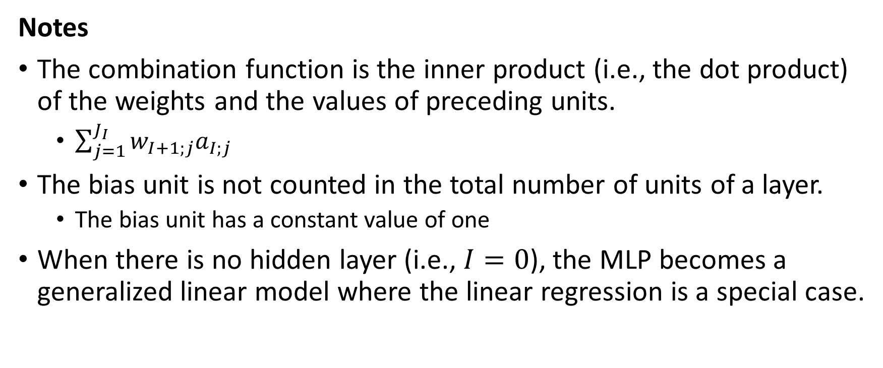
The Mathematical Representation
Notes
The combination function is the inner product (i.e., the dot product) of the weights and the values of preceding units.
$\sum_{j=1}^{J_{I}}{w_{I+1;j}a_{I;j}}$
The bias unit is not counted in the total number of units of a layer.
The bias unit has a constant value of one
When there is no hidden layer (i.e., $I=0$), the MLP becomes a generalized linear model where the linear regression is a special case.

Slide 27
Activation Functions for Hidden Layer
Hyperbolic Tangent
$$γ\left(c\right) =tanh\left(c\right)$$
$$=\frac{\exp\left(c\right)−exp⁡\left(−c\right)}{\exp\left(c\right)+exp⁡\left(−c\right)}=\frac{2}{1+exp\left(−2c\right)}−1$$
Hyperbolic Tangent
𝛾(𝑐) =tanh(𝑐)
=(exp⁡(𝑐)−exp⁡(−𝑐))/(exp⁡(𝑐)+exp⁡(−𝑐) )=2/(1+exp(−2𝑐) )−1
Logistic (a.k.a. Sigmoid)
$$γ\left(c\right)=\frac{1}{1+exp\left(−c\right)}$$
Logistic (a.k.a. Sigmoid)
𝛾(𝑐)=1/(1+exp(−𝑐) )

Slide 28
Activation Functions for Hidden Layer
Identity
$$γ\left(c\right)=c$$
Identity
𝛾(𝑐)=𝑐
Rectifier (ReLU)
$$γ\left(c\right)=max⁡(0,c)$$
ReLU = Rectifier Linear Unit
Rectifier (ReLU)
𝛾(𝑐)=max⁡(0,𝑐)
ReLU = Rectifier Linear Unit

Slide 29
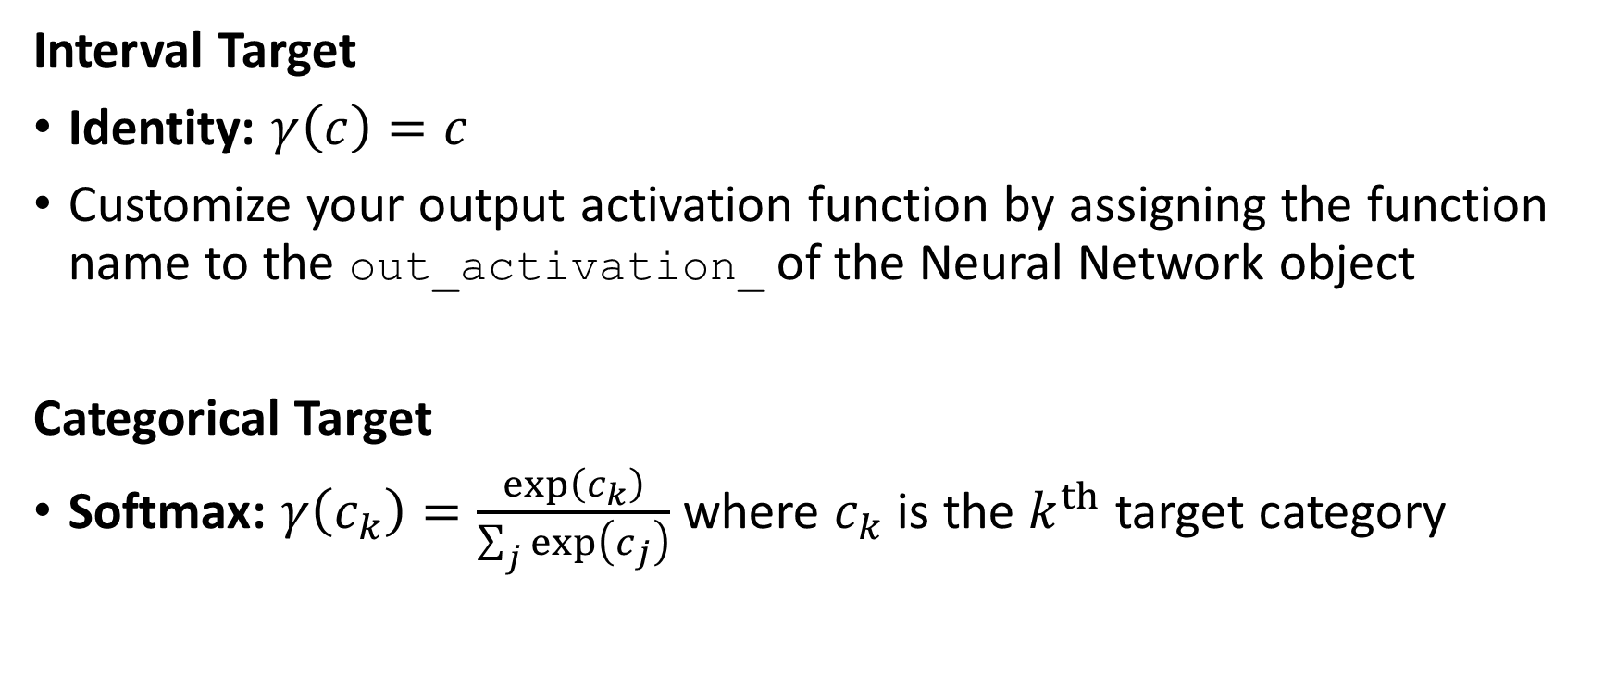
Activation Functions for Output Layer
Interval Target
Identity: $γ\left(c\right)=c$
Customize your output activation function by assigning the function name to the out_activation_ of the Neural Network object
Categorical Target
Softmax: $γ\left(c_{k}\right)=\frac{exp⁡\left(c_{k}\right)}{\sum_{j}{exp⁡\left(c_{j}\right)}}$ where $c_{k}$ is the $k^{th}$ target category

Slide 30
Rescale Interval Input Features
To avoid numerical problems due to differences in magnitudes of input features, the input features are often rescaled for analyses.
Mid-range
Result: the midpoint is 0, the minimum is -1 and the maximum of 1
Range
$$y=\frac{x−x_{min}}{x_{max}−x_{min}}$$
𝑦=(𝑥−𝑥_𝑚𝑖𝑛)/(𝑥_𝑚𝑎𝑥−𝑥_𝑚𝑖𝑛 )
Result: the minimum is 0 and the maximum is 1
Standardize
$$y=\frac{x−\overline{x}}{s_{x}}$$
𝑦=(𝑥−𝑥 ̅)/𝑠_𝑥
Result: the mean is 0 and the standard deviation is 1
$$y=\frac{\left(\left(x−x_{min}\right)−\left(x_{max}−x\right)\right)}{x_{max}−x_{min}}$$
𝑦=(((𝑥−𝑥_𝑚𝑖𝑛 )−(𝑥_𝑚𝑎𝑥−𝑥)))/(𝑥_𝑚𝑎𝑥−𝑥_𝑚𝑖𝑛 )

Slide 31
Rescale Input Features
Interval Features
Consider mid-range or range if the input features are bounded
e.g., age, height, test score
Use standard deviation for general input features
Categorical Features
Use dummy indicators for the categories
Not need to rescale these dummy indicators because:
They are, statistically speaking, not interval features
Their values are already 0 and 1

Slide 32
The Cost Function
The cost function, denoted as $C\left(y,\hat{y}\right)$, depends on the observed target and the predictions
The cost function, denoted as 𝐶(𝑦,𝑦 ̂ ), depends on the observed target and the predictions
The predictions $\hat{y}$ are values of the units $a_{I+1;1},…,a_{I+1;J_{I+1}}$ in the output layer
The predictions 𝑦 ̂ are values of the units 𝑎_(𝐼+1;1),…,𝑎_(𝐼+1;𝐽_(𝐼+1) ) in the output layer
Minimize the total cost $L=\sum_{j=1}^{J_{I+1}}{C\left(y_{I+1;j},a_{I+1;j}\right)}$ with respect to all the synaptic weights
Minimize the total cost 𝐿=∑_(𝑗=1)^(𝐽_(𝐼+1))▒𝐶(𝑦_(𝐼+1;𝑗),𝑎_(𝐼+1;𝑗) ) with respect to all the synaptic weights
The observed target values are $y_{I+1;1},…,y_{I+1;J_{I+1}}$
The observed target values are 𝑦_(𝐼+1;1),…,𝑦_(𝐼+1;𝐽_(𝐼+1) )

Slide 33
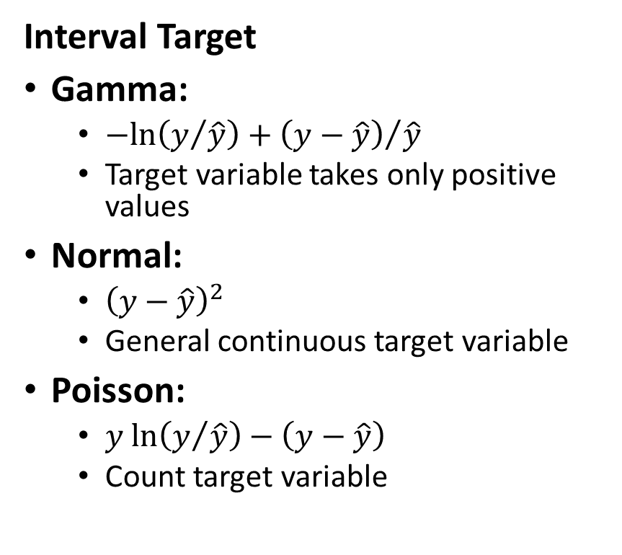
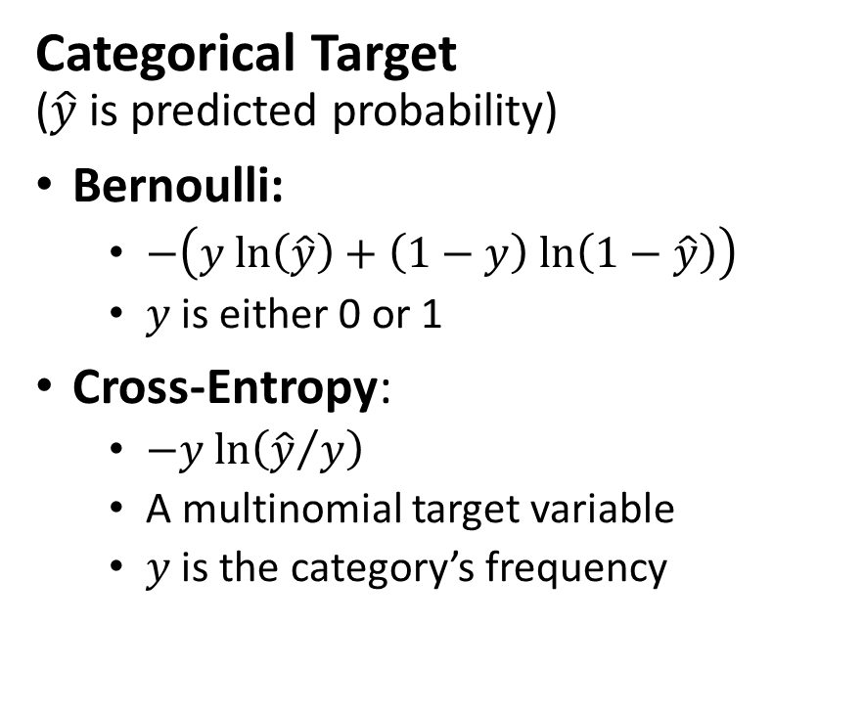
Common Cost Function
Interval Target
Gamma:
$−ln\left(y/{\hat{y}}\right)+{\left(y−\hat{y}\right)}/{\hat{y}}$
Target variable takes only positive values
Normal:
${\left(y−\hat{y}\right)}^{2}$
General continuous target variable
Poisson:
$y ln\left(y/{\hat{y}}\right)−\left(y−\hat{y}\right)$
Count target variable
Categorical Target ($\hat{y}$ is predicted probability)
Bernoulli:
$−\left(y ln\left(\hat{y}\right)+\left(1−y\right) ln\left(1−\hat{y}\right)\right)$
$y$ is either 0 or 1
Cross-Entropy:
$−y ln\left({\hat{y}}/y\right)$
A multinomial target variable
$y$ is the category’s frequency

Slide 34
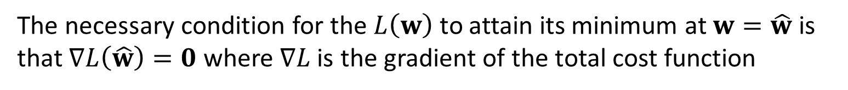
Estimate the Synaptic Weights (Basic Concept)
The vector of Synaptic Weights $w=\left(w_{i;j}\right)$
The vector of Synaptic Weights 𝐰=(𝑤_(𝑖;𝑗) )
Minimize $L\left(w\right)$ with respect to $w$
Minimize 𝐿(𝐰) with respect to 𝐰
Solve $∇L\left(\hat{w}\right)=0$ for $\hat{w}$
Solve ∇𝐿(𝐰 ̂ )=𝟎 for 𝐰 ̂
The necessary condition for the $L\left(w\right)$ to attain its minimum at $w=\hat{w}$ is that $∇L\left(\hat{w}\right)=0$ where $∇L$is the gradient of the total cost function

Slide 35
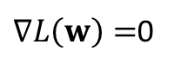
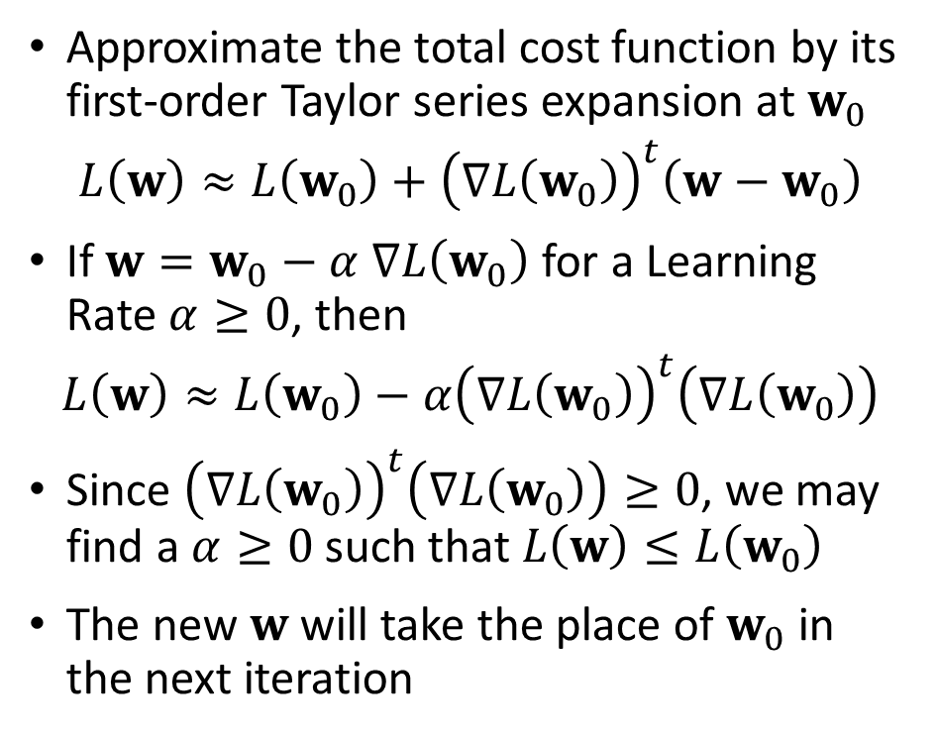
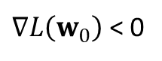
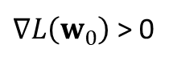
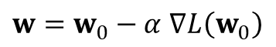
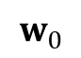
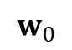
The Gradient Descent Method
Approximate the total cost function by its first-order Taylor series expansion at $w_{0}$
$$L\left(w\right)≈L\left(w_{0}\right)+{\left(∇L\left(w_{0}\right)\right)}^{t}\left(w−w_{0}\right)$$
If $w=w_{0}−α$ $∇L\left(w_{0}\right)$ for a Learning Rate $α≥0$, then
$$L\left(w\right)≈L\left(w_{0}\right)−α{\left(∇L\left(w_{0}\right)\right)}^{t}\left(∇L\left(w_{0}\right)\right)$$
Since ${\left(∇L\left(w_{0}\right)\right)}^{t}\left(∇L\left(w_{0}\right)\right)≥0$, we may find a $α≥0$ such that $L\left(w\right)≤L\left(w_{0}\right)$
The new $w$ will take the place of $w_{0}$ in the next iteration
$∇L\left(w_{0}\right)$ > 0
$∇L\left(w_{0}\right)$ < 0
$∇L\left(w\right)=$0
$w=w_{0}−α$ $∇L\left(w_{0}\right)$
$$w_{0}$$
$$w_{0}$$

Slide 36
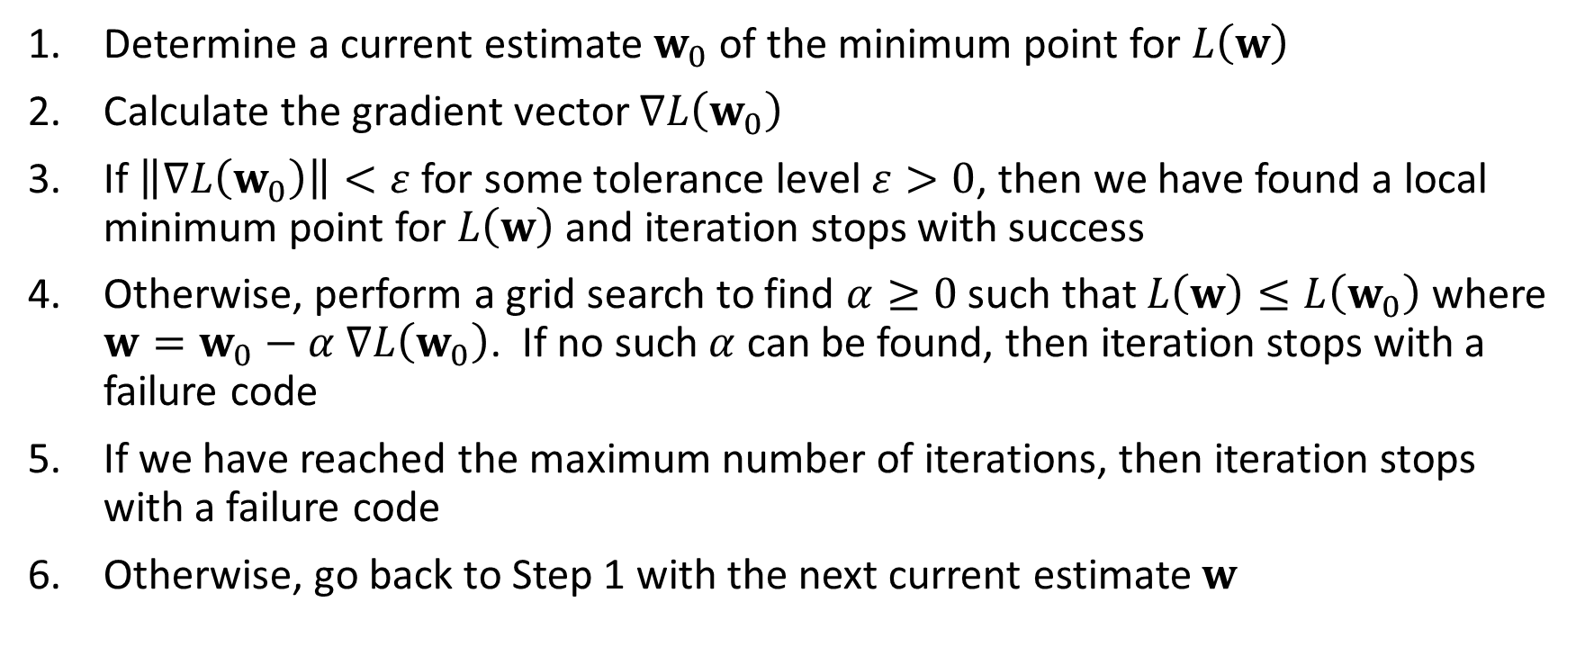
The Gradient Descent Method
Determine a current estimate $w_{0}$of the minimum point for $L\left(w\right)$
Calculate the gradient vector $∇L\left(w_{0}\right)$
If $\left\|∇L\left(w_{0}\right)\right\|<ε$ for some tolerance level $ε>0$, then we have found a local minimum point for $L\left(w\right)$ and iteration stops with success
Otherwise, perform a grid search to find $α≥0$ such that $L\left(w\right)≤L\left(w_{0}\right)$ where $w=w_{0}−α$ $∇L\left(w_{0}\right)$. If no such $α$ can be found, then iteration stops with a failure code
If we have reached the maximum number of iterations, then iteration stops with a failure code
Otherwise, go back to Step 1 with the next current estimate $w$

Slide 37
Calculating the Gradient Vector
Calculating the gradient vector $∇L\left(w\right)$ can be overwhelming
Calculating the gradient vector ∇𝐿(𝐰) can be overwhelming
Use the Backpropagation algorithm to calculate the gradient vector
Backpropagation algorithm applies the Chain Rule in repeatedly

Slide 38
Calculus Chain Rule
$y=f\left(u\right)$, $u=g\left(v\right)$, and $v=h\left(x\right)$
𝑦=𝑓(𝑢), 𝑢=𝑔(𝑣), and 𝑣=ℎ(𝑥)
Chain Rule says $\frac{dy}{dx}=\frac{dy}{du}$ $\frac{du}{dv}$ $\frac{dv}{dx}$
Chain Rule says 𝑑𝑦/𝑑𝑥=𝑑𝑦/𝑑𝑢 𝑑𝑢/𝑑𝑣 𝑑𝑣/𝑑𝑥
$\frac{dy}{dx}=f^{′}\left(g\left(h\left(x\right)\right)\right)g^{′}\left(h\left(x\right)\right)$ $h^{′}\left(x\right)$
𝑑𝑦/𝑑𝑥=𝑓^′ (𝑔(ℎ(𝑥))) 𝑔^′ (ℎ(𝑥)) ℎ^′ (𝑥)

Slide 39
Illustration Using this Neural Network
Bias
Y1
H(2:0)
H(1:0)
H(3:0)
X1
H(2:1)
Y2
X2
H(1:1)
H(3:1)
H(2:2)
Y3
X3
Input Layer
Hidden Layer(s)
Output Layer

Slide 40
Backpropagation Algorithm Illustration (Simplify Notations)
X₀
y₁
h₂₀
h₁₀
h₃₀
x₁
h₂₁
y₂
x₂
h₁₁
h₃₁
h₂₂
y₃
x₃
Input Layer
Hidden Layer(s)
Output Layer

Slide 41
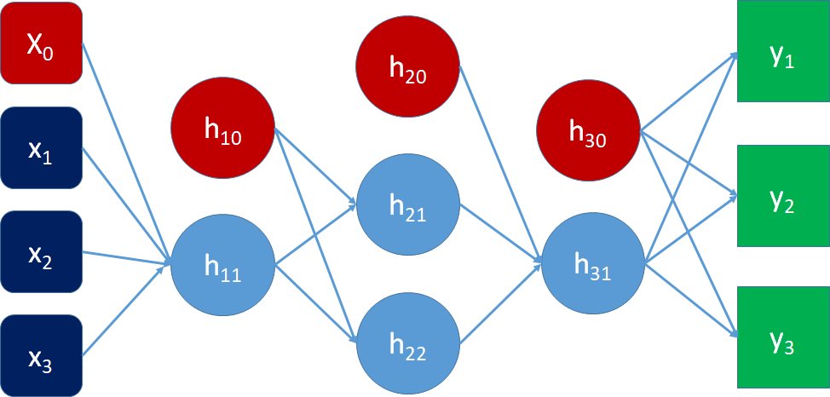
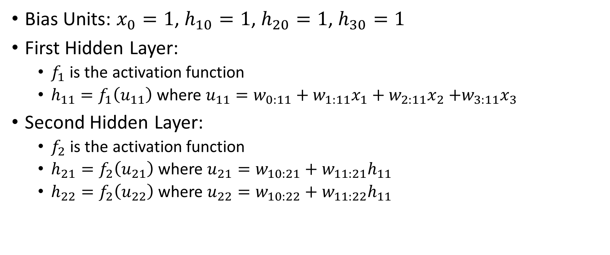
Backpropagation Algorithm Illustration
Bias Units: $x_{0}=1$, $h_{10}=1$, $h_{20}=1$, $h_{30}=1$
First Hidden Layer:
$f_{1}$ is the activation function
$h_{11}=f_{1}\left(u_{11}\right)$ where $u_{11}=w_{0:11}+w_{1:11}x_{1}+w_{2:11}x_{2}$ $+w_{3:11}x_{3}$
Second Hidden Layer:
$f_{2}$ is the activation function
$h_{21}=f_{2}\left(u_{21}\right)$ where $u_{21}=w_{10:21}+w_{11:21}h_{11}$
$h_{22}=f_{2}\left(u_{22}\right)$ where $u_{22}=w_{10:22}+w_{11:22}h_{11}$

Slide 42
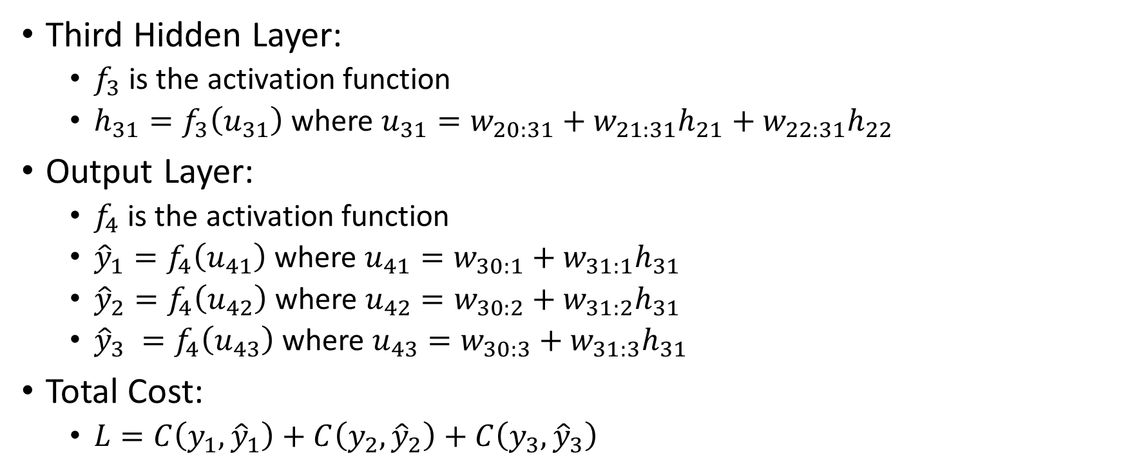
Backpropagation Algorithm Illustration
Third Hidden Layer:
$f_{3}$ is the activation function
$h_{31}=f_{3}\left(u_{31}\right)$ where $u_{31}=w_{20:31}+w_{21:31}h_{21}+w_{22:31}h_{22}$
Output Layer:
$f_{4}$ is the activation function
${\hat{y}}_{1}=f_{4}\left(u_{41}\right)$ where $u_{41}=w_{30:1}+w_{31:1}h_{31}$
${\hat{y}}_{2}=f_{4}\left(u_{42}\right)$ where $u_{42}=w_{30:2}+w_{31:2}h_{31}$
${\hat{y}}_{3} =f_{4}\left(u_{43}\right)$ where $u_{43}=w_{30:3}+w_{31:3}h_{31}$
Total Cost:
$L=C\left(y_{1},{\hat{y}}_{1}\right)+C\left(y_{2},{\hat{y}}_{2}\right)+C\left(y_{3},{\hat{y}}_{3}\right)$

Slide 43
Backpropagation Algorithm Illustration
$$\frac{∂L}{∂w}=\frac{∂C}{∂{\hat{y}}_{1}}\frac{∂{\hat{y}}_{1}}{∂w}+\frac{∂C}{∂{\hat{y}}_{2}}\frac{∂{\hat{y}}_{2}}{∂w}+\frac{∂C}{∂{\hat{y}}_{3}}\frac{∂{\hat{y}}_{3}}{∂w}$$
𝜕𝐿/𝜕𝑤=𝜕𝐶/(𝜕𝑦 ̂_1 ) (𝜕𝑦 ̂_1)/𝜕𝑤+𝜕𝐶/(𝜕𝑦 ̂_2 ) (𝜕𝑦 ̂_2)/𝜕𝑤+𝜕𝐶/(𝜕𝑦 ̂_3 ) (𝜕𝑦 ̂_3)/𝜕𝑤
Know the form of the cost function $C\left(y_{i},{\hat{y}}_{i}\right)$
We can explicitly calculate $\frac{∂C}{∂{\hat{y}}_{i}}$ for $i=1,2,3$
Know the form of the cost function 𝐶(𝑦_𝑖,𝑦 ̂_𝑖 )
We can explicitly calculate 𝜕𝐶/(𝜕𝑦 ̂_𝑖 ) for 𝑖=1,2,3
We focus on calculating $\frac{∂{\hat{y}}_{i}}{∂w}$ for $i=1,2,3$
We focus on calculating (𝜕𝑦 ̂_𝑖)/𝜕𝑤 for 𝑖=1,2,3

Slide 44

Backpropagation Algorithm Key Concept
Start from the Output Layer
Work Backward One Hidden Layer at a Time
Finish at the Input Layer

Slide 45
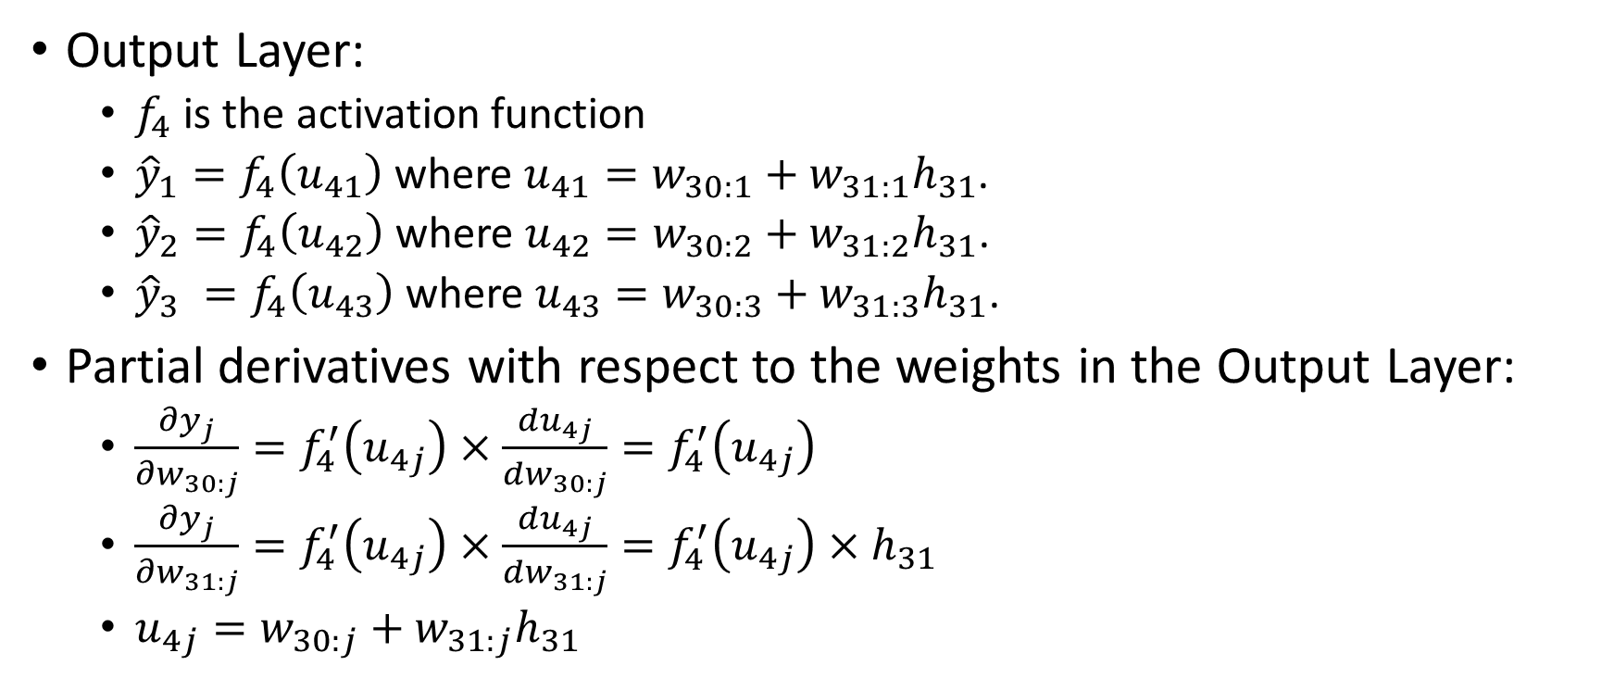
Backpropagation: Output Layer
Output Layer:
$f_{4}$ is the activation function
${\hat{y}}_{1}=f_{4}\left(u_{41}\right)$ where $u_{41}=w_{30:1}+w_{31:1}h_{31}$.
${\hat{y}}_{2}=f_{4}\left(u_{42}\right)$ where $u_{42}=w_{30:2}+w_{31:2}h_{31}$.
${\hat{y}}_{3} =f_{4}\left(u_{43}\right)$ where $u_{43}=w_{30:3}+w_{31:3}h_{31}$.
Partial derivatives with respect to the weights in the Output Layer:
$\frac{∂y_{j}}{∂w_{30:j}}=f_{4}^{′}\left(u_{4j}\right)×\frac{du_{4j}}{dw_{30:j}}=f_{4}^{′}\left(u_{4j}\right)$
$\frac{∂y_{j}}{∂w_{31:j}}=f_{4}^{′}\left(u_{4j}\right)×\frac{du_{4j}}{dw_{31:j}}=f_{4}^{′}\left(u_{4j}\right)×h_{31}$
$u_{4j}=w_{30:j}+w_{31:j}h_{31}$

Slide 46
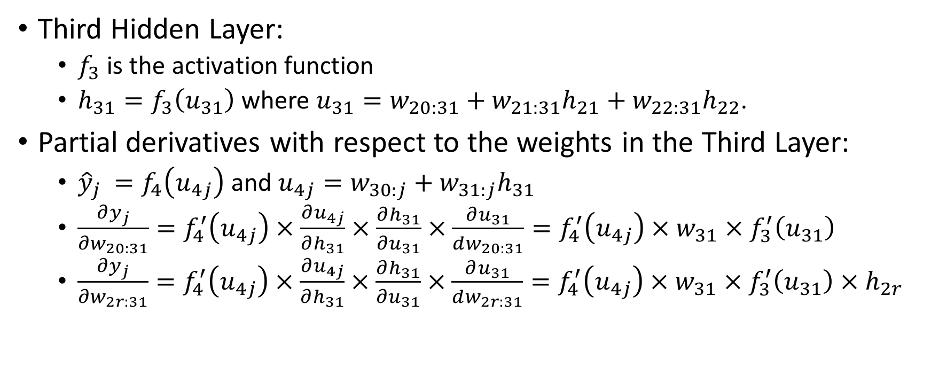
Backpropagation: Third Hidden Layer
Third Hidden Layer:
$f_{3}$ is the activation function
$h_{31}=f_{3}\left(u_{31}\right)$ where $u_{31}=w_{20:31}+w_{21:31}h_{21}+w_{22:31}h_{22}$.
Partial derivatives with respect to the weights in the Third Layer:
${\hat{y}}_{j} =f_{4}\left(u_{4j}\right)$ and $u_{4j}=w_{30:j}+w_{31:j}h_{31}$
$\frac{∂y_{j}}{∂w_{20:31}}=f_{4}^{′}\left(u_{4j}\right)×\frac{∂u_{4j}}{∂h_{31}}×\frac{∂h_{31}}{∂u_{31}}×\frac{∂u_{31}}{dw_{20:31}}=f_{4}^{′}\left(u_{4j}\right)×w_{31}×f_{3}^{′}\left(u_{31}\right)$
$\frac{∂y_{j}}{∂w_{2r:31}}=f_{4}^{′}\left(u_{4j}\right)×\frac{∂u_{4j}}{∂h_{31}}×\frac{∂h_{31}}{∂u_{31}}×\frac{∂u_{31}}{dw_{2r:31}}=f_{4}^{′}\left(u_{4j}\right)×w_{31}×f_{3}^{′}\left(u_{31}\right)×h_{2r}$

Slide 47
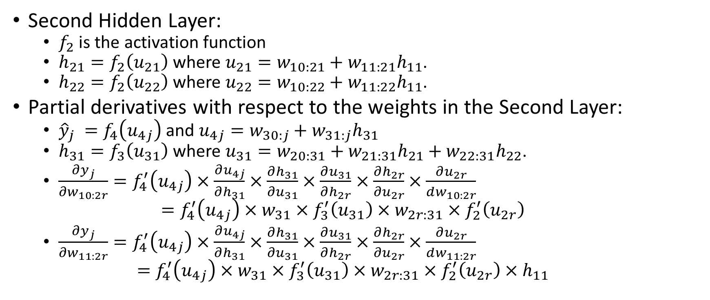
Backpropagation: Second Hidden Layer
Second Hidden Layer:
$f_{2}$ is the activation function
$h_{21}=f_{2}\left(u_{21}\right)$ where $u_{21}=w_{10:21}+w_{11:21}h_{11}$.
$h_{22}=f_{2}\left(u_{22}\right)$ where $u_{22}=w_{10:22}+w_{11:22}h_{11}$.
Partial derivatives with respect to the weights in the Second Layer:
${\hat{y}}_{j} =f_{4}\left(u_{4j}\right)$ and $u_{4j}=w_{30:j}+w_{31:j}h_{31}$
$h_{31}=f_{3}\left(u_{31}\right)$ where $u_{31}=w_{20:31}+w_{21:31}h_{21}+w_{22:31}h_{22}$.
$\frac{∂y_{j}}{∂w_{10:2r}}=f_{4}^{′}\left(u_{4j}\right)×\frac{∂u_{4j}}{∂h_{31}}×\frac{∂h_{31}}{∂u_{31}}×\frac{∂u_{31}}{∂h_{2r}}×\frac{∂h_{2r}}{∂u_{2r}}×\frac{∂u_{2r}}{dw_{10:2r}}$ $=f_{4}^{′}\left(u_{4j}\right)×w_{31}×f_{3}^{′}\left(u_{31}\right)×w_{2r:31}×f_{2}^{′}\left(u_{2r}\right)$
$\frac{∂y_{j}}{∂w_{11:2r}}=f_{4}^{′}\left(u_{4j}\right)×\frac{∂u_{4j}}{∂h_{31}}×\frac{∂h_{31}}{∂u_{31}}×\frac{∂u_{31}}{∂h_{2r}}×\frac{∂h_{2r}}{∂u_{2r}}×\frac{∂u_{2r}}{dw_{11:2r}}$ $=f_{4}^{′}\left(u_{4j}\right)×w_{31}×f_{3}^{′}\left(u_{31}\right)×w_{2r:31}×f_{2}^{′}\left(u_{2r}\right)×h_{11}$

Slide 48
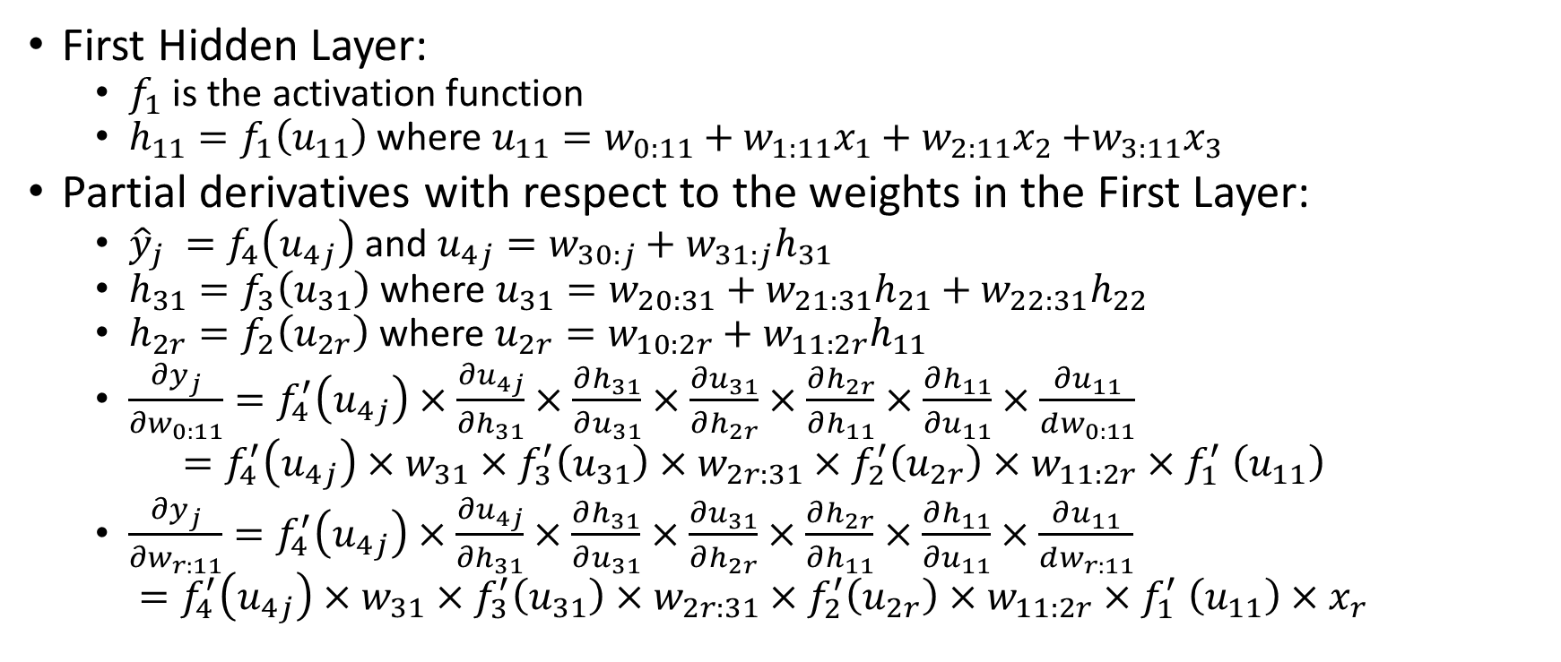
Backpropagation: First Hidden Layer
First Hidden Layer:
$f_{1}$ is the activation function
$h_{11}=f_{1}\left(u_{11}\right)$ where $u_{11}=w_{0:11}+w_{1:11}x_{1}+w_{2:11}x_{2}$ $+w_{3:11}x_{3}$
Partial derivatives with respect to the weights in the First Layer:
${\hat{y}}_{j} =f_{4}\left(u_{4j}\right)$ and $u_{4j}=w_{30:j}+w_{31:j}h_{31}$
$h_{31}=f_{3}\left(u_{31}\right)$ where $u_{31}=w_{20:31}+w_{21:31}h_{21}+w_{22:31}h_{22}$
$h_{2r}=f_{2}\left(u_{2r}\right)$ where $u_{2r}=w_{10:2r}+w_{11:2r}h_{11}$
$\frac{∂y_{j}}{∂w_{0:11}}=f_{4}^{′}\left(u_{4j}\right)×\frac{∂u_{4j}}{∂h_{31}}×\frac{∂h_{31}}{∂u_{31}}×\frac{∂u_{31}}{∂h_{2r}}×\frac{∂h_{2r}}{∂h_{11}}×\frac{∂h_{11}}{∂u_{11}}×\frac{∂u_{11}}{dw_{0:11}}$ $=f_{4}^{′}\left(u_{4j}\right)×w_{31}×f_{3}^{′}\left(u_{31}\right)×w_{2r:31}×f_{2}^{′}\left(u_{2r}\right)×w_{11:2r}{×f}_{1}^{′}\left(u_{11}\right)$
$\frac{∂y_{j}}{∂w_{r:11}}=f_{4}^{′}\left(u_{4j}\right)×\frac{∂u_{4j}}{∂h_{31}}×\frac{∂h_{31}}{∂u_{31}}×\frac{∂u_{31}}{∂h_{2r}}×\frac{∂h_{2r}}{∂h_{11}}×\frac{∂h_{11}}{∂u_{11}}×\frac{∂u_{11}}{dw_{r:11}}$ $=f_{4}^{′}\left(u_{4j}\right)×w_{31}×f_{3}^{′}\left(u_{31}\right)×w_{2r:31}×f_{2}^{′}\left(u_{2r}\right)×w_{11:2r}{×f}_{1}^{′}\left(u_{11}\right)×x_{r}$

Slide 49
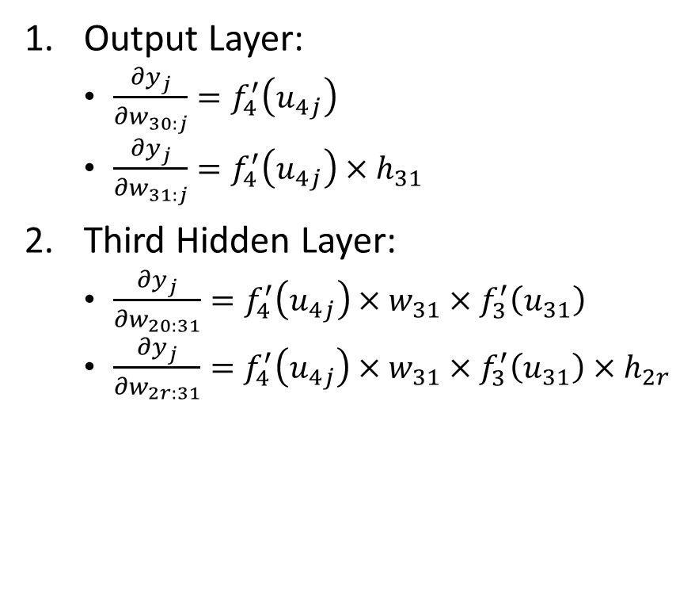
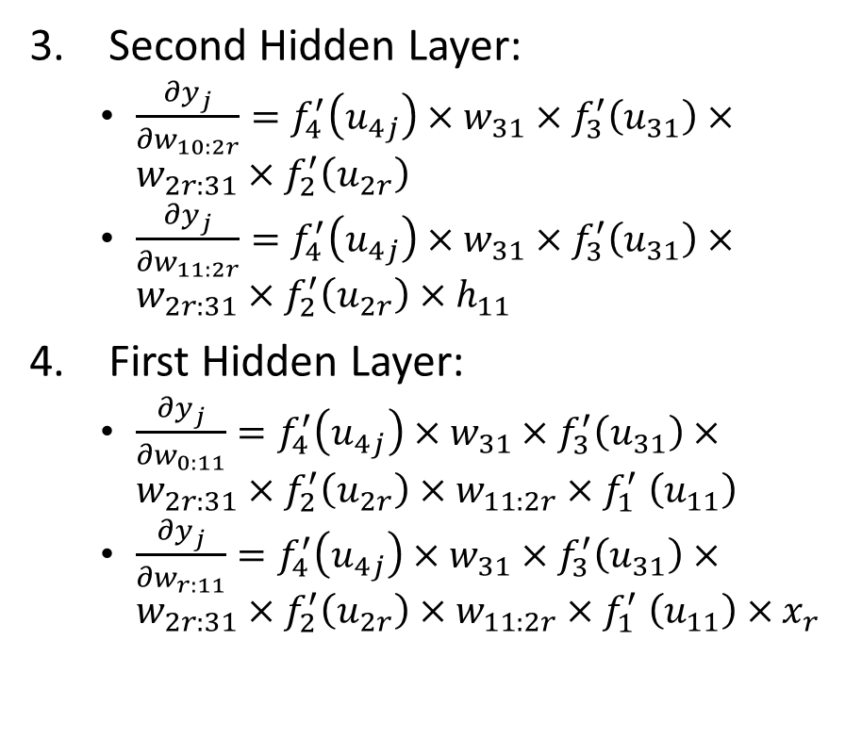
Backpropagation Algorithm Summary
Output Layer:
$\frac{∂y_{j}}{∂w_{30:j}}=f_{4}^{′}\left(u_{4j}\right)$
$\frac{∂y_{j}}{∂w_{31:j}}=f_{4}^{′}\left(u_{4j}\right)×h_{31}$
Third Hidden Layer:
$\frac{∂y_{j}}{∂w_{20:31}}=f_{4}^{′}\left(u_{4j}\right)×w_{31}×f_{3}^{′}\left(u_{31}\right)$
$\frac{∂y_{j}}{∂w_{2r:31}}=f_{4}^{′}\left(u_{4j}\right)×w_{31}×f_{3}^{′}\left(u_{31}\right)×h_{2r}$
Second Hidden Layer:
$\frac{∂y_{j}}{∂w_{10:2r}}=f_{4}^{′}\left(u_{4j}\right)×w_{31}×f_{3}^{′}\left(u_{31}\right)×w_{2r:31}×f_{2}^{′}\left(u_{2r}\right)$
$\frac{∂y_{j}}{∂w_{11:2r}}=f_{4}^{′}\left(u_{4j}\right)×w_{31}×f_{3}^{′}\left(u_{31}\right)×w_{2r:31}×f_{2}^{′}\left(u_{2r}\right)×h_{11}$
First Hidden Layer:
$\frac{∂y_{j}}{∂w_{0:11}}=f_{4}^{′}\left(u_{4j}\right)×w_{31}×f_{3}^{′}\left(u_{31}\right)×w_{2r:31}×f_{2}^{′}\left(u_{2r}\right)×w_{11:2r}{×f}_{1}^{′}\left(u_{11}\right)$
$\frac{∂y_{j}}{∂w_{r:11}}=f_{4}^{′}\left(u_{4j}\right)×w_{31}×f_{3}^{′}\left(u_{31}\right)×w_{2r:31}×f_{2}^{′}\left(u_{2r}\right)×w_{11:2r}{×f}_{1}^{′}\left(u_{11}\right)×x_{r}$
The partial derivatives in a layer depend on the:
Values of the hidden nodes of the current layer and the subsequent layers
Values of the weights of the subsequent layers.

Slide 50
Backpropagation Algorithm Illustration
For current estimates of the weights
Perform a feedforward scoring of the neural network to get the predictions.
Calculate the partial derivatives in the Output Layer, update the weights in that layer using the gradient descent method.
Calculate the partial derivatives in the Third Hidden Layer, update the weights in that layer using the gradient descent method.
Calculate the partial derivatives in the Second Hidden Layer, update the weights in that layer using the gradient descent method.
Calculate the partial derivatives in the First Hidden Layer, update the weights in that layer using the gradient descent method.
Repeat Step 1 to 6 until convergence.

Slide 51
The sklearn.neural_network Module
hidden_layer_sizes = (nHiddenNeuron,)*nLayer specifies nHiddenNeuron number of hidden neuron in each of the nLayer layers
Learning rate schedule for weight updates learning_rate: {‘constant’, ‘invscaling’, ‘adaptive’} default is ‘constant’
Activation function for the hidden layer: activation: {‘identity’, ‘logistic’, ‘tanh’, relu’} default is ‘relu’
It controls the step-size in updating the weights learning_rate_init: positive double default is 0.001
Maximum number of iterations max_iter: positive integer default is 200
Random State random_state: positive integer default is None
Categorical Target: sklearn.neural_network.MLPClassifier function
Interval Target: sklearn.neural_network.MLPRegressor

Slide 52
Learning Rate: Find the Middle Ground
Slow Learning Rate (e.g., 0.01)
More likely to converge to the minimum
Take more iterations to find the minimum
Fast Learning Rate (e.g., 1.0)
May bound around or run away from the minimum
Take fewer iterations if minimum can be found

Slide 53
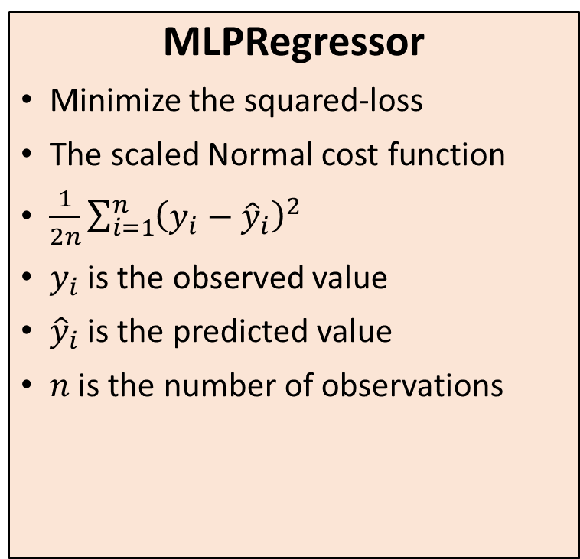
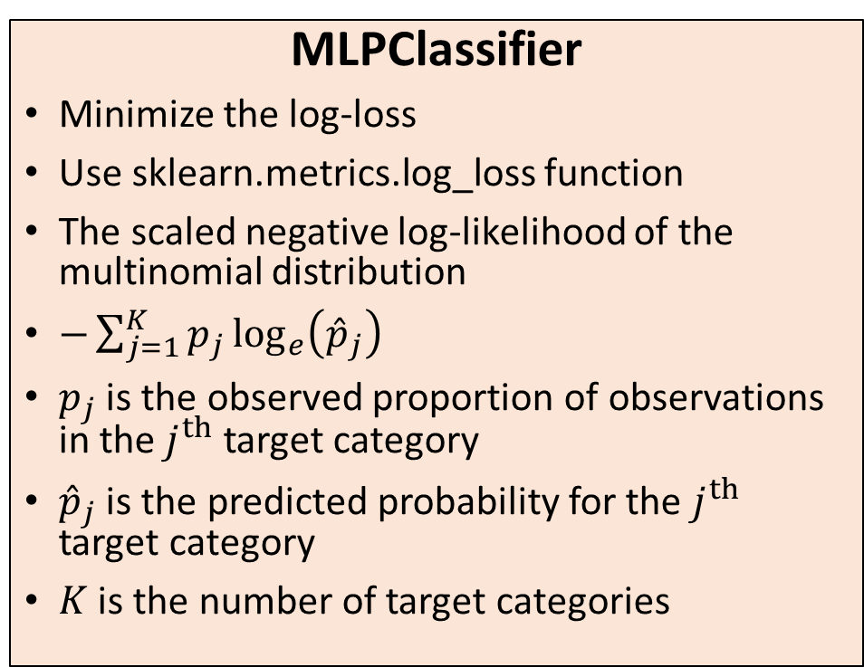
Cost Function in sklearn.neural_network
MLPRegressor
Minimize the squared-loss
The scaled Normal cost function
$\frac{1}{2n}\sum_{i=1}^{n}{{\left(y_{i}−{\hat{y}}_{i}\right)}^{2}}$
$y_{i}$ is the observed value
${\hat{y}}_{i}$ is the predicted value
$n$ is the number of observations
MLPClassifier
Minimize the log-loss
Use sklearn.metrics.log_loss function
The scaled negative log-likelihood of the multinomial distribution
$−\sum_{j=1}^{K}{p_{j}\log_{e}\left({\hat{p}}_{j}\right)}$
$p_{j}$ is the observed proportion of observations in the $j^{th}$ target category
${\hat{p}}_{j}$ is the predicted probability for the $j^{th}$ target category
$K$ is the number of target categories

Slide 54
Back to Our Toy Example
Week 11 Toy Neural Network.py
sklearn. neural_network. MLPRegressor
Activation = 'relu'
learning_rate_init = 0.1
max_iter = 5000
random_state = 20191030
Solver = 'lbfgs'

Slide 55
Back to Our Toy Example
Week 11 Toy Neural Network.py
Number of Hidden Layers
Try 1, 2, 3, 4, 5, 6, 7, 8, 9
Number of Neurons per Hidden Layer
Try 5, 10, 15, 20
Assessment Metrics
Loss function is the Root Mean Square Residual
R Square is the correlation between Observed and Predicted values

Slide 56
Back to Our Toy Example
Week 11 Toy Neural Network.py
def Build_NN_Toy (nLayer, nHiddenNeuron):
# Build Neural Network
nnObj = nn.MLPRegressor(hidden_layer_sizes = (nHiddenNeuron,)*nLayer, activation = 'relu', verbose = False,
solver = 'lbfgs', learning_rate_init = 0.1, max_iter = 5000, random_state = 20191030)
# nnObj.out_activation_ = 'identity'
thisFit = nnObj.fit(xVar, y)
y_pred = nnObj.predict(xVar)
Loss = nnObj.loss_
RSquare = metrics.r2_score(y, y_pred)
# Plot the prediction
plt.figure(figsize=(10,6))
plt.plot(xVar, y, linewidth = 2, marker = '+', color = 'black', label = 'Data')
plt.plot(xVar, y_pred, linewidth = 2, marker = 'o', color = 'red', label = 'Prediction')
plt.grid(True)
plt.xlabel("x")
plt.ylabel("y")
plt.title("%d Hidden Layers, %d Hidden Neurons" % (nLayer, nHiddenNeuron))
plt.legend(fontsize = 12, markerscale = 3)
plt.show()
return (Loss, RSquare)

Slide 57
Back to Our Toy Example
Week 11 Toy Neural Network.py
xVar = pandas.DataFrame(x, columns = ['x'])
result = pandas.DataFrame(columns = ['nLayer', 'nHiddenNeuron', 'Loss', 'RSquare'])
for i in numpy.arange(1,10):
for j in numpy.arange(5,25,5):
Loss, RSquare = Build_NN_Toy (nLayer = i, nHiddenNeuron = j)
result = result.append(pandas.DataFrame([[i, j, Loss, RSquare]],
columns = ['nLayer', 'nHiddenNeuron', 'Loss', 'RSquare']))

Slide 58








Back to Our Toy Example
Number of Layers
1
2
5
10
15
20
Number of Neurons

Slide 59








Back to Our Toy Example
3
4
5
10
15
20

Slide 60








Back to Our Toy Example
5
6
5
10
15
20

Slide 61








Back to Our Toy Example
7
8
5
10
15
20

Slide 62




Back to Our Toy Example
9
5
10
15
20

Slide 63
Back to Our Toy Example
N Layer | N Hidden Neuron | Loss | R Square
1 | 5 | 0.10456 | 0.78449
1 | 10 | 0.10456 | 0.78449
1 | 15 | 0.00225 | 0.99539
1 | 20 | 0.10456 | 0.78449
2 | 5 | 0.10456 | 0.78449
2 | 10 | 0.00015 | 0.99970
2 | 15 | 0.00035 | 0.99931
2 | 20 | 0.00013 | 0.99977
3 | 5 | 0.00034 | 0.99933
3 | 10 | 0.00011 | 0.99979
3 | 15 | 0.00014 | 0.99975
3 | 20 | 0.00005 | 0.99992
N Layer | N Hidden Neuron | Loss | R Square
4 | 5 | 0.48519 | 0.00000
4 | 10 | 0.00015 | 0.99971
4 | 15 | 0.00011 | 0.99981
4 | 20 | 0.00008 | 0.99989
5 | 5 | 0.00049 | 0.99901
5 | 10 | 0.00047 | 0.99906
5 | 15 | 0.00004 | 0.99996
5 | 20 | 0.00007 | 0.99992
6 | 5 | 0.00035 | 0.99931
6 | 10 | 0.00004 | 0.99995
6 | 15 | 0.00007 | 0.99991
6 | 20 | 0.00006 | 0.99994
N Layer | N Hidden Neuron | Loss | R Square
7 | 5 | 0.01017 | 0.97907
7 | 10 | 0.00004 | 0.99995
7 | 15 | 0.00006 | 0.99994
7 | 20 | 0.00007 | 0.99995
8 | 5 | 0.00015 | 0.99972
8 | 10 | 0.00035 | 0.99935
8 | 15 | 0.00010 | 0.99989
8 | 20 | 0.00015 | 0.99978
9 | 5 | 0.48520 | 0.00000
9 | 10 | 0.00006 | 0.99992
9 | 15 | 0.00011 | 0.99985
9 | 20 | 0.00006 | 0.99997

Slide 64
Back to Our Toy Example
Loss Cost
First Place
Loss cost is 3.91E-05
Occur at 5 hidden layers and 15 neurons per layer
Second Place
Loss cost is 4.10E-05
Occur at 6 hidden layers and 10 neurons per layer
R-Square
First Place
R-square is 0.999972
Occur at 9 hidden layers and 20 neurons per layer
Second Place
R-square coefficient is 0.999960
Occur at 5 hidden layers and 15 neurons per layer

Slide 65


Comparison

Slide 66
Classification Neural Network on Cars
sklearn. neural_network. MLPClassifier
Target: DriveTrain
learning_rate_init = 0.1
max_iter = 10000
random_state = 20201104
Solver = 'lbfgs'
Categorical Feature: Type, Origin, Cylinders
Interval Feature: EngineSize, Horsepower, MPG_City, MPG_Highway, Weight, Wheelbase, Length
Number of Layers: 1, 2, 3, 4, 5, 6, 7, 8, 9, 10
Number of Neurons Per Layer: 5, 10, 15, 20
Goodness-of-Fit:
Root Average Squared Error
Activation Function: identity, logistic, relu, tanh

Slide 67
Classification Neural Network on Cars
Week 11 Cars Neural Network.py
inputData = pandas.read_csv(
'C:\\Users\\minlam\\Documents\\IIT\\Machine Learning\\Data\\cars.csv',
delimiter=',')
target = 'DriveTrain'
catPred = ['Type','Origin','Cylinders']
intPred = ['EngineSize','Horsepower','MPG_City','MPG_Highway','Weight','Wheelbase','Length']
inputData[catPred] = inputData[catPred].astype('category')
X = pandas.get_dummies(inputData[catPred].astype('category'))
X = X.join(inputData[intPred])
y = inputData[target].astype('category')
y_category = y.cat.categories
y_dummy = pandas.get_dummies(y).to_numpy(dtype = float)

Slide 68
Classification Neural Network on Cars
Week 11 Cars Neural Network.py
def Build_NN_Class (actFunc, nLayer, nHiddenNeuron):
# Build Neural Network
nnObj = nn.MLPClassifier(hidden_layer_sizes = (nHiddenNeuron,)*nLayer,
activation = actFunc, verbose = False,
solver = 'lbfgs', learning_rate_init = 0.1,
max_iter = 10000, random_state = 20201104)
thisFit = nnObj.fit(X, y)
y_predProb = nnObj.predict_proba(X)
# Calculate Root Average Squared Error
y_residual = y_dummy - y_predProb
rase = numpy.sqrt(numpy.mean(y_residual ** 2))
return (rase)

Slide 69
Classification Neural Network on Cars
Week 11 Cars Neural Network.py
result = pandas.DataFrame(
columns = ['Activation Function', 'nLayer', 'nHiddenNeuron', 'RASE'])
for i in numpy.arange(1,11):
for j in numpy.arange(5,25,5):
for act in ['identity','logistic','relu','tanh']:
RASE = Build_NN_Class (actFunc = act, nLayer = i, nHiddenNeuron = j)
result = result.append(
pandas.DataFrame([[act, i, j, RASE]],
columns = ['Activation Function', 'nLayer',
'nHiddenNeuron', 'RASE']),
ignore_index=True)

Slide 70

Classification Neural Network on Cars
Comments
The identity activation function generates RASE over a wide range
The logistic and the tanh activation functions tend to produce a constant (or almost constant) RASE
The RELU activation function can generate quite low RASE

Slide 71

Classification Neural Network on Cars
Comments
More layers bring the RASE down
However, do not overdo it because the 10-layers solution generates RASE over a wide range

Slide 72

Classification Neural Network on Cars
Comments
Too few neurons and too many neurons per layer do not necessarily generate low RASE
Need to find the delicate balance

Slide 73
Classification Neural Network on Cars
Activation Function | Number of Layers | Number of Hidden Neurons Per Layer | Root Average Squared Error
relu | 1 | 10 | 0.339931
identity | 4 | 15 | 0.340524
relu | 10 | 10 | 0.355239
identity | 9 | 5 | 0.357415
relu | 8 | 15 | 0.361307
relu | 9 | 10 | 0.365300
relu | 10 | 15 | 0.366171
tanh | 9 | 10 | 0.368771
relu | 5 | 15 | 0.370680
relu | 9 | 15 | 0.372216
Lowest Ten RASEs
Lowest RASE comes from a one-layer NN with 10 neurons and RELU activation function
Second lowest RASE comes from a four-layer NN with 15 neurons each layer and an identity activation function

Slide 74
Classification Neural Network on Cars (relu / 1 Layer / 10 Neurons Per Layer)
# Train this NN: RELU, 1-layer, 10-neurons each
actFunc = 'relu'
nLayer = 1
nHiddenNeuron = 10
nnObj = nn.MLPClassifier(hidden_layer_sizes = (nHiddenNeuron,)*nLayer,
activation = actFunc, verbose = False,
solver = 'lbfgs', learning_rate_init = 0.1,
max_iter = 10000, random_state = 20201104)
thisFit = nnObj.fit(X, y)
y_predProb = nnObj.predict_proba(X)

Slide 75

Visualize Classification Accuracy (relu / 1 Layer / 10 Neurons Per Layer)
Paneled histogram
Ideally, the bars should concentrate at 0 (1) when the observed category is different from (same as ) that of the predicted probability.

Slide 76
Some After Thoughts
Search manually over a grid for an optimal combination of the number of hidden layers and the number of neurons in these layers
Add more hidden layers can reduce the Loss
Add more neurons to a hidden layer can lower the Loss

Slide 77

Computing Resources
Increase the number of neurons in a hidden layer
Increase the number of partial derivatives calculated in the Backpropagation algorithm
Require more computer memory for storing these partial derivatives
Increase the number of hidden layers
Increase the number of steps in the Backpropagation algorithm
Lead to longer execution times

Slide 78
A Few Words on Deep Learning
Deep learning is a type of machine learning that trains a computer to perform human-like tasks, such as recognizing speech, identifying images or making predictions.
Instead of organizing data to run through predefined equations, deep learning sets up basic parameters about the data and trains the computer to learn on its own by recognizing patterns using many layers of processing.
New classes of neural networks have been developed that fit well for applications like text translation and image classification.

Slide 79

Convolution Neural Networks (CNN)
CNNs are designed to take image data as input.
The layers in a CNN have 3 dimensions: width, height, and depth.
Every layer of a CNN transforms the 3-dimensional input volume to a 3-dimensional output volume of neuron activations.
Credit: http://cs231n.github.io/convolutional-networks/

Slide 80
Recurrent Neural Networks (RNN)
Designed to handle Sequence Data: speech, text, and time series
Recurrent: perform the same task for every element of a sequence
Forecasting and time series
Input is numeric sequence data
Output is a single numeric value or a nominal target value
Sentiment analysis and text categorization
Input is text data
Output is a single numeric value or a nominal target value (happiness)
Automatic speech recognition
Input is a numeric sequence (e.g., sound wave characteristics)
Output is nominal labels (e.g., words or phrases) for the input sequence
Text summarization, and simple question and answer
Input is text (original text)
Output is also text (keywords or concepts)

